Slide 1
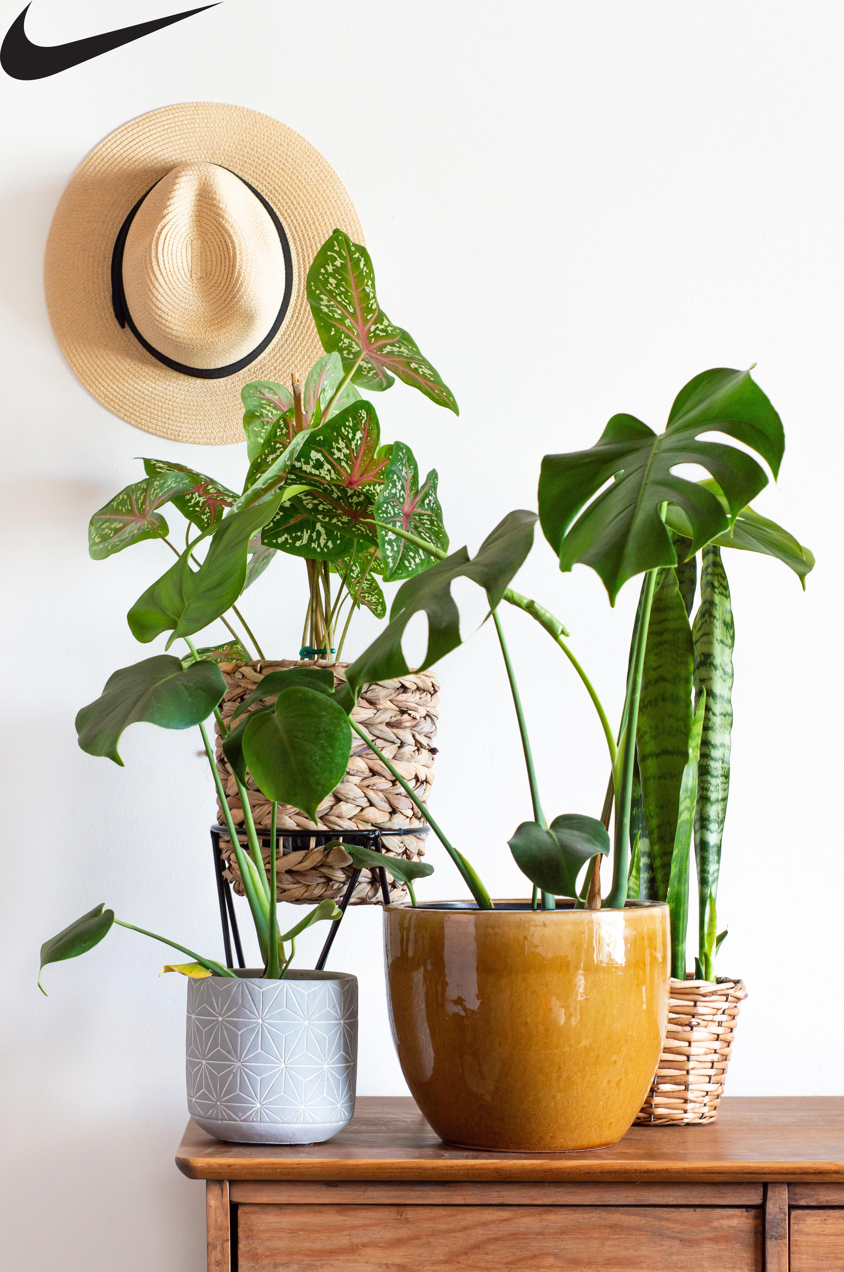
Assignment
watermark5 image

Slide 2


Slide 3


Slide 4


Slide 5


